Slide 1

Image Scraping and Classification Project
By
Nimit Shah

Slide 2
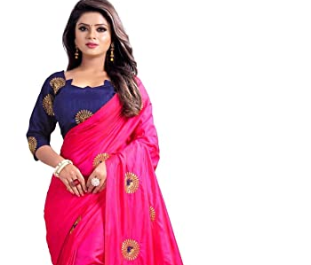
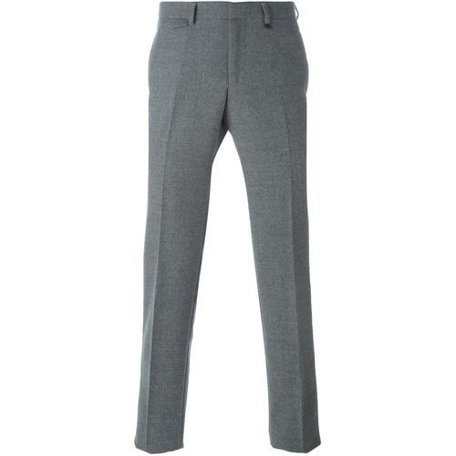
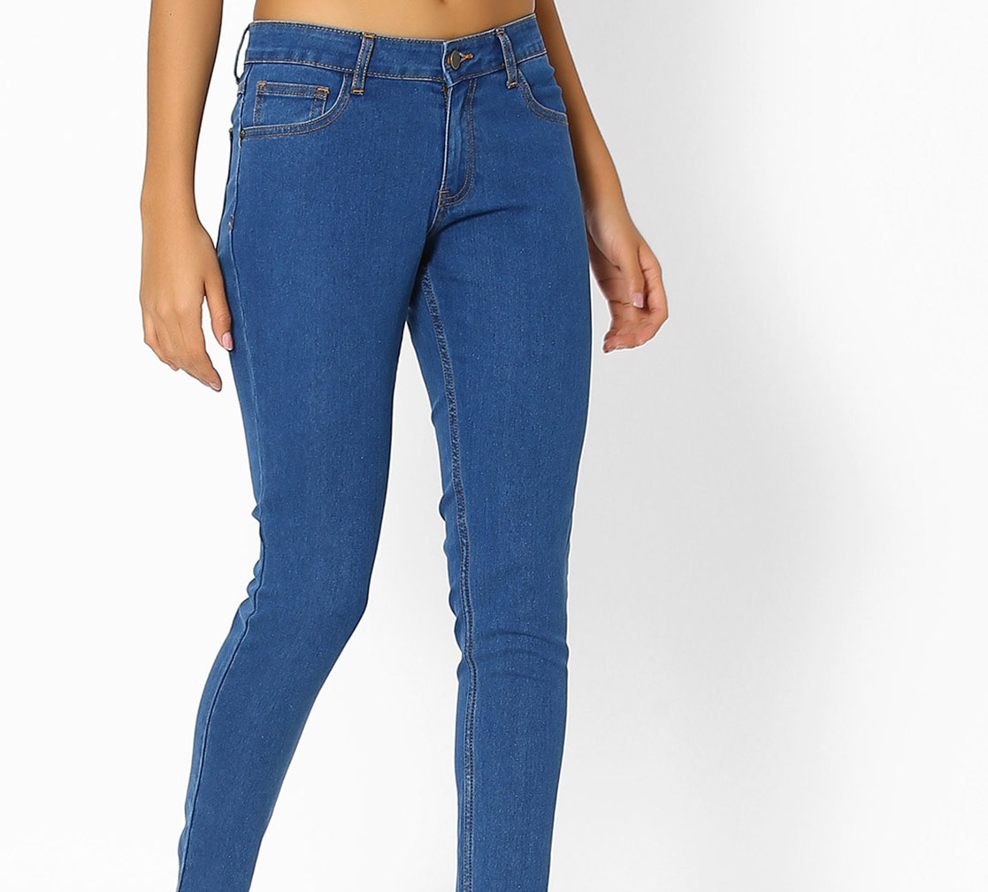
Problem Statement
Building a model which can classify between trousers, sarees and Jeans

Slide 3
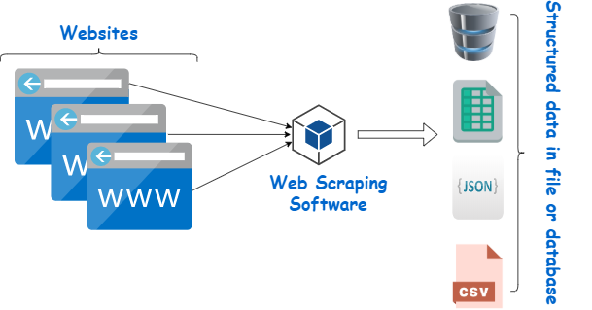
Step 1: Scrapping data from Amazon and flipkart website
Amazon website data scrapped is the training data
Flipkart website scrapped is the test data

Slide 4
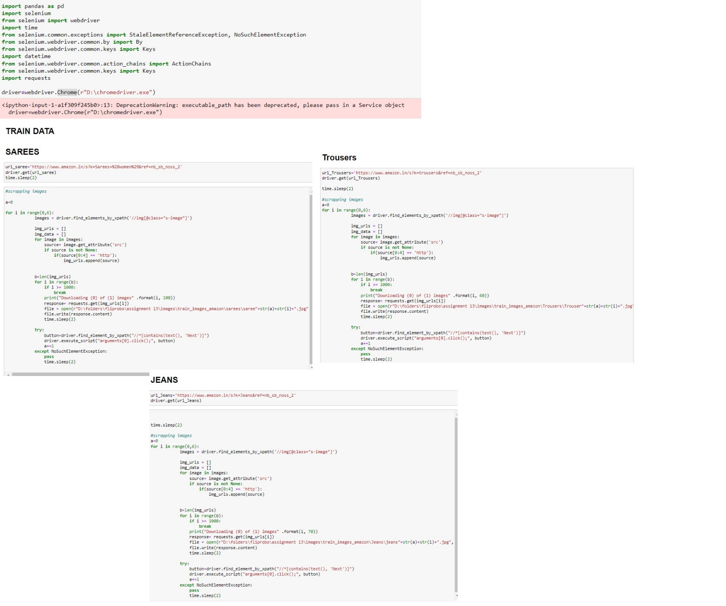

Slide 5
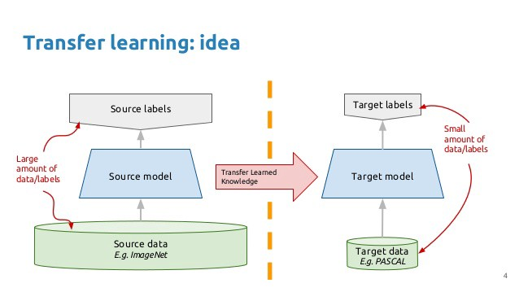
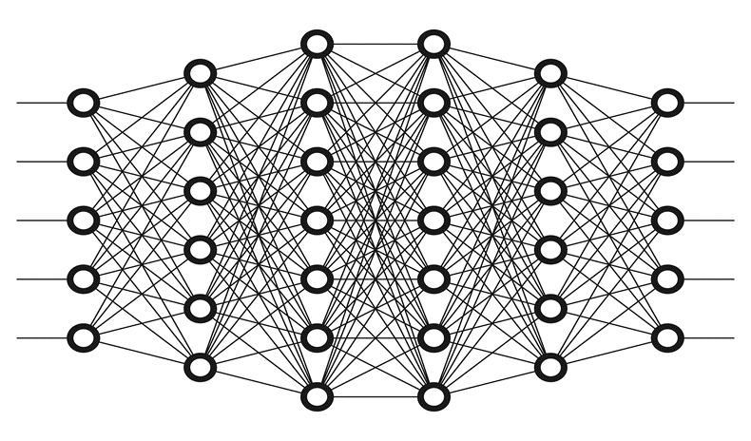
Step 2: Model building through transfer learning

Slide 6
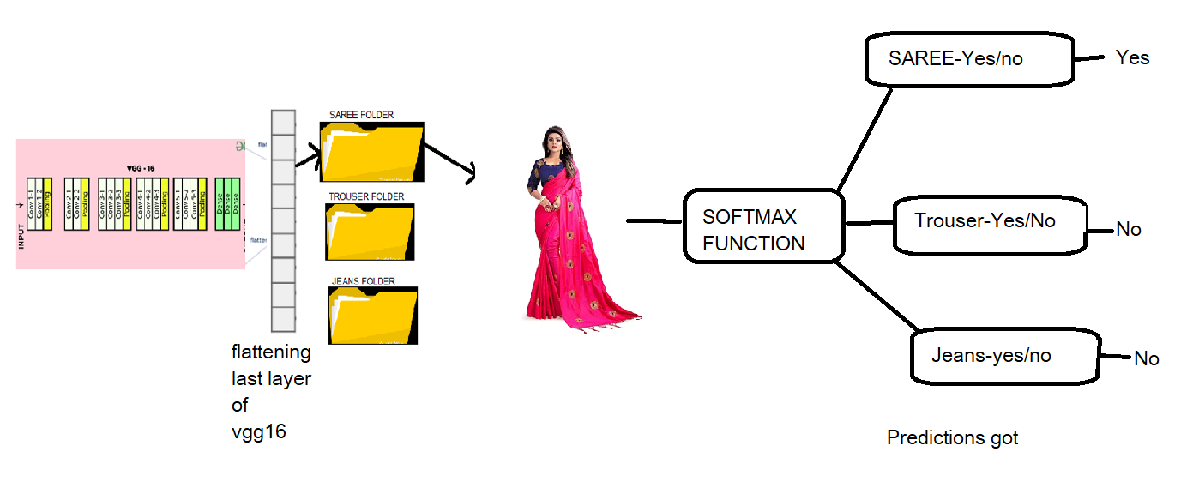
CREATING THE MODEL AND OUTPUT DATA FOR MODELLING

Slide 7
Loading the libraries
Loading the data
Loading the model with no last layer
Not letting the layers of the transfer models train and
The same weights need to be used
The output from the transfer model is flattened
Locating the folders of the scrapped images
The folder of images is appended as Dense layer to the flattened Transfer model. This is passed to the Softmax activation function

Slide 8
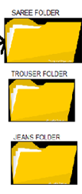
Model structure
InputLayer
Conv2D
Conv2D
MaxPooling2D
Conv2D
Conv2D
MaxPooling2D
Conv2D
Conv2D
Conv2D
MaxPooling2D
Conv2D
Conv2D
Conv2D
MaxPooling2D
Conv2D
Conv2D
Conv2D
MaxPooling2D
Flatten

Slide 9
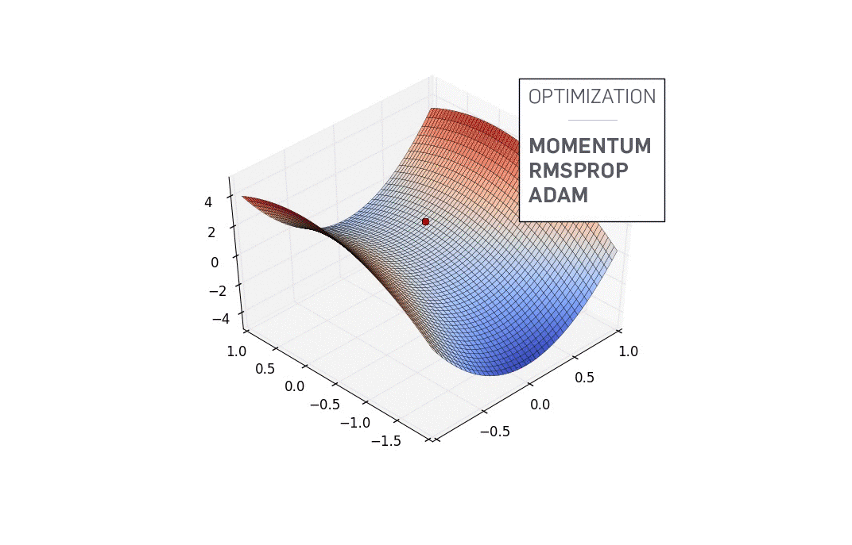
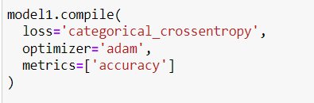
MODEL COMPILATION USING BACKPROPOGATION AND OPTIMISATION

Slide 10
Model is created with the backpropogation occurring
Compiling the model with the optimum optimiser, Loss calculation method and metrics used to understand the accuracy of prediction
image augmentation techniques is used to increase the size of the data but making sure the quality of data is not compromised
Applying the trained model on the test data and finding the accuracy

Slide 11
Loading the data
Loading the libraries

Slide 12
Loading the model with no last layer
Not letting the layers of the transfer models train and
The same weights need to be used

Slide 13
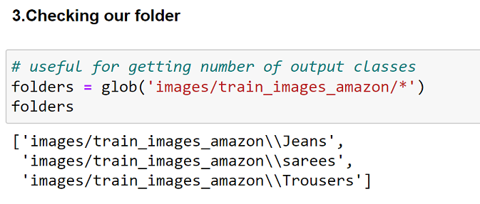
Locating the folders
The output from the tranfer model is flattened

Slide 14
Model is created with the backpropogation occurring
The folder of images is appended as Dense layer to the flattened Transfer model. This is passed to the Softmax activation function

Slide 15
Compiling the model with the optimum optimiser, Loss calculation method and metrics used to understand the accuracy of prediction
image augmentation techniques is used to increase the size of the data but making sure the quality of data is not compromised

Slide 16
Applying the trained model on the test data and finding the accuracy

Slide 17
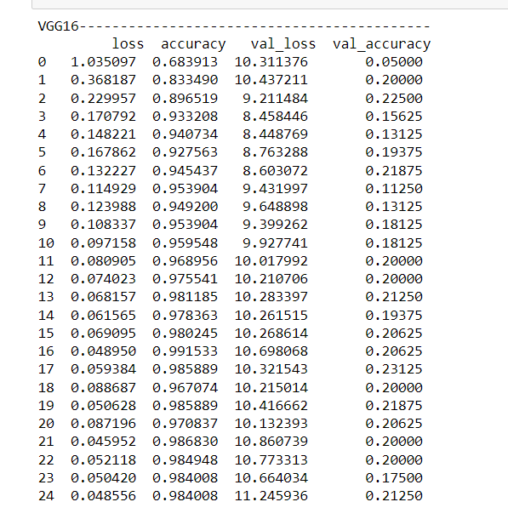
Step 3:Choosing the best model and saving it
Best model is vgg 16 with 16 epochs

Slide 18
Technology Used for the Project
Hardware technology being used.
RAM : 8 GB
CPU :Intel® Core™ i7-10510U CPU @ 1.80GHz
GPU: NVIDA-Cuda , performed in tf_gpu_env enviroment
Software technology being used.
Programming language : Python
Distribution : Anaconda Navigator
Browser based language shell : Jupyter Notebook
Libraries/Packages specifically being used.
Pandas , NumPy, matplotlib, Tensorflow, keras

Slide 19
Identified Transfer learning techniques for classification
VGG16
VGG19
ResNet50

Slide 20
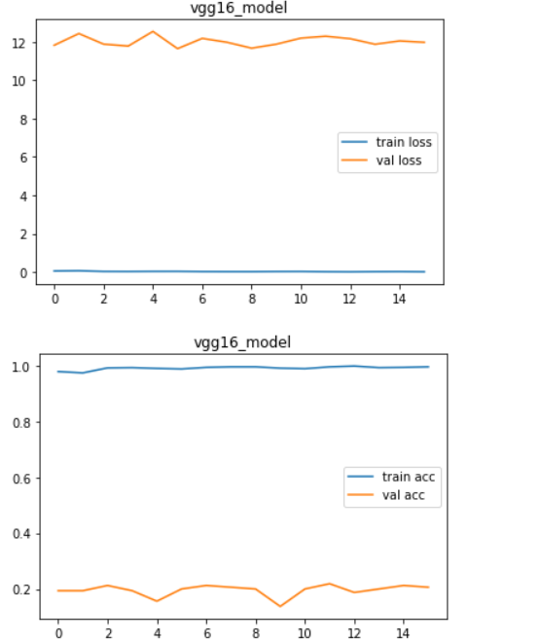
Accuracy Graph and loss graph of the chosen model

Slide 21
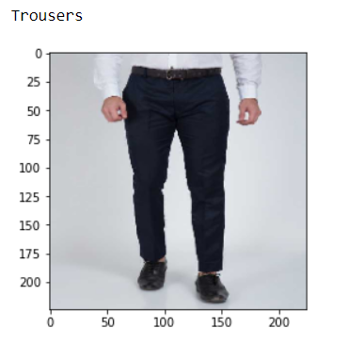
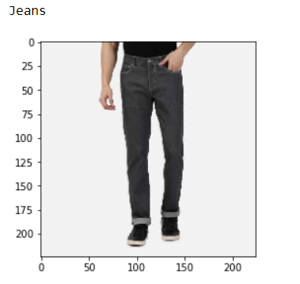
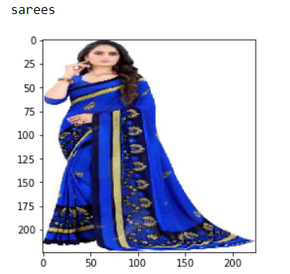
Accuracy of model

Slide 22
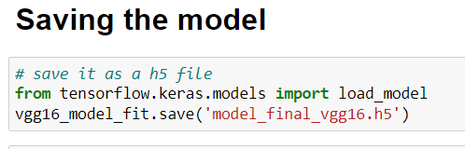
Saving the model

Slide 23
THANK YOU Have a nice day

